Slide 1

Developing Aging Clocks for Fish Using DNA Methylation
Ellen m. Weise (emweise@dal.ca, @allelellie) &
Christopher Corriveau (christopher.corriveau@dal.ca)
Lab PI: Daniel Ruzzante (daniel.ruzzante@dal.ca)

Slide 2
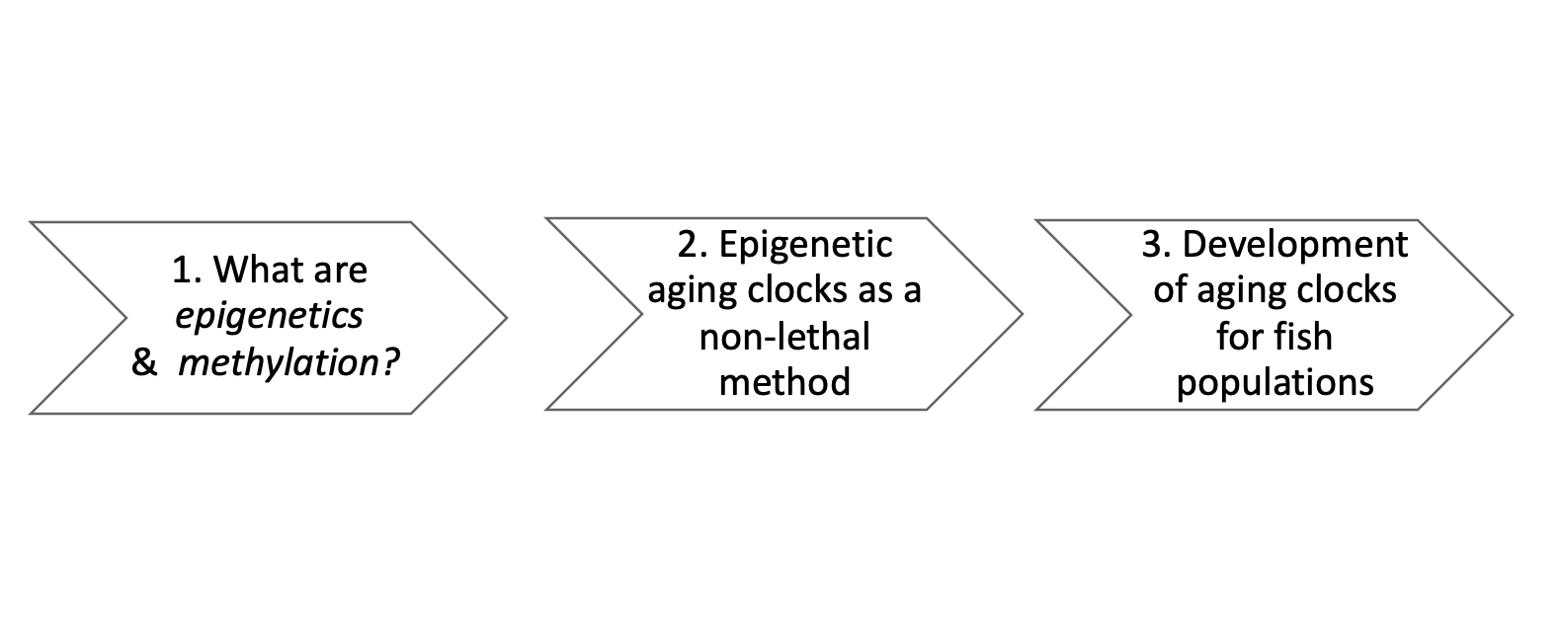
Presentation Road Map

Slide 3
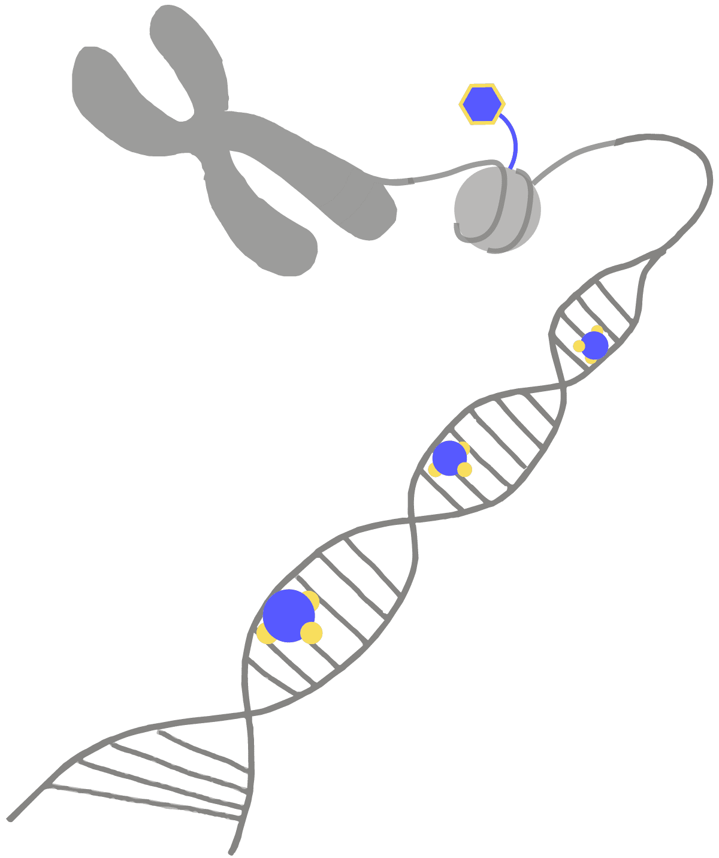
“Epigenetics”
Histone modifications
Chemical or physical changes to genetic material; not to the fundamental language of a gene (A, C, G, T)
These changes can be discreet and missed by some traditional genetic sequencing techniques.
These tend to be plastic changes – meaning they fluctuate with development, age, environment, etc.
Often have regulatory implications for gene expression
Methylation

Slide 4
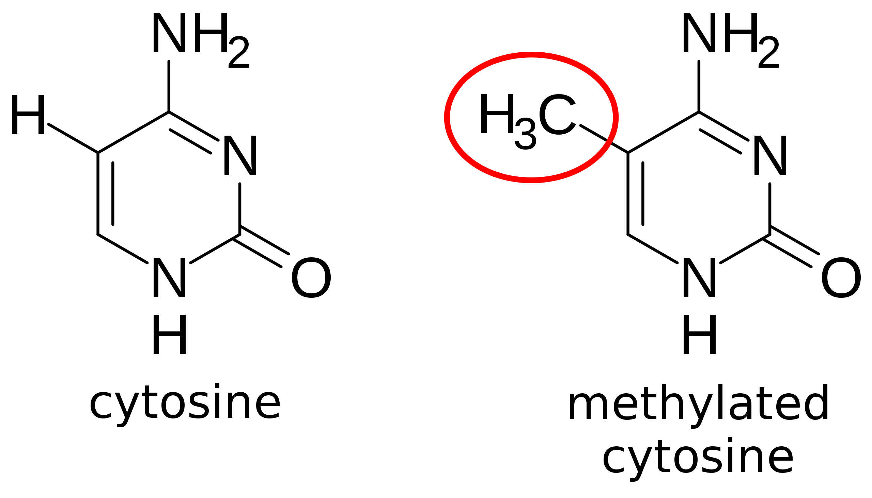

What is methylation?
epigenetic modifications
M
M
M

Slide 5
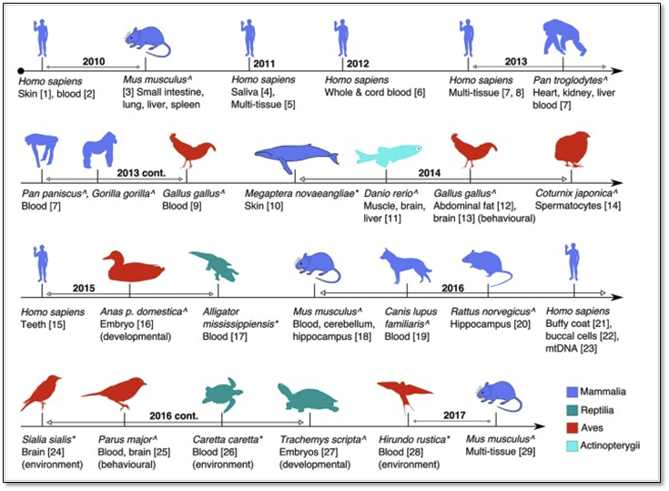
Some context...
Recently, amount of methylation on the genome have been found to correlate with development and aging
The informative power of methylation as a genetic tool to estimate age can be species, tissue, and even individual specific
Methylation is the most well-studied epigenetic mechanism – covering many applications and on a wide range of species
Few have considered fish and fewer still have developed working models which can estimate age in fish
FIGURE 1 | Timeline of the major studies and tissues analysed for global or targeted DNA methylation in this review. Studies are age-associated except where indicated. (De Paoli-Iseppi et al., 2017)

Slide 6
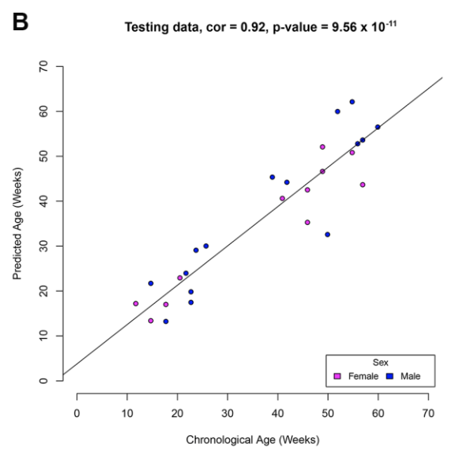
Methylation Aging Clocks
Correlating methylated sites with age
Can be used to estimate age from a genomic sample
Need to identify specific methylation sites for each species first
Use known-age fish first to calibrate the clock
Mayne et al 2020

Slide 7
Development of methylation aging clocks
/
1. Select known-age fish
2. Methylation sequencing
3. Selecting sites correlated with age
4. Sequencing of unknown-age fish at aging sites
5. Age estimation of unknown-age fish
Notes:
Need otolith or hatchery data for known ages
Method uses known age data generated from known sources
Uses selected markers for age identification in unknown individuals

Slide 8
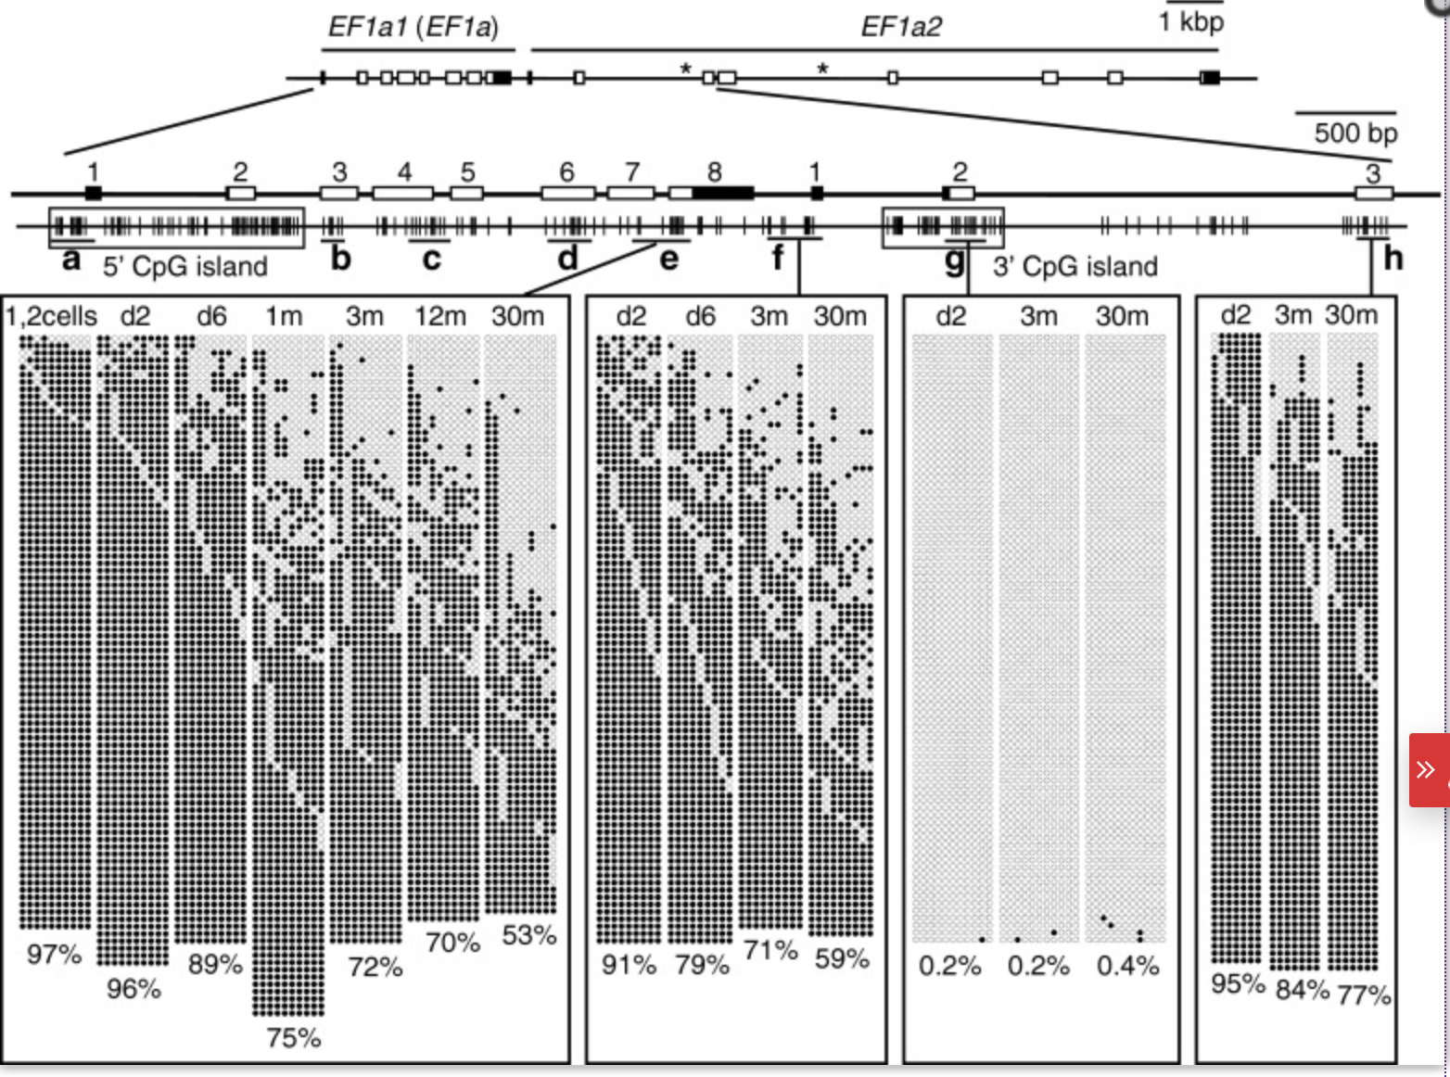
Methylation Sites
Whole-genome methylation sequences all potential sites
Not all are related to age
Age related methylation sites exist across the genome
need to be filtered
Shimoda et al 2014

Slide 9
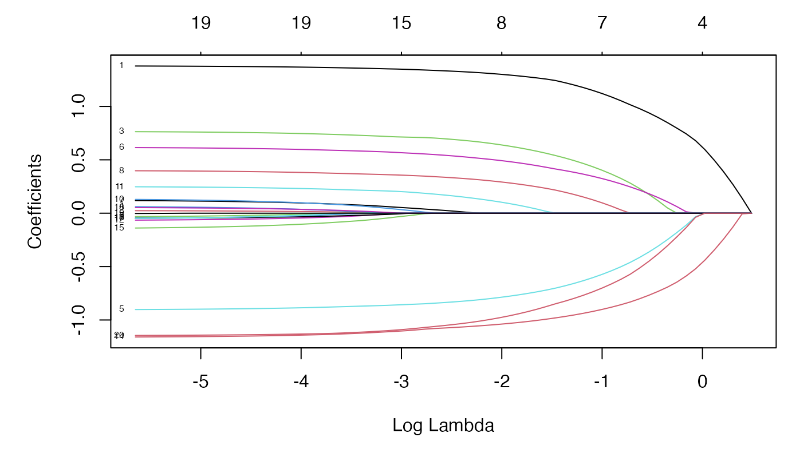
Elastic Net Regression
Method to select important predictors from large groups of potential variables
more explanatory sites will stay non-zero for longer
Select cut-off for ‘important site’

Slide 10
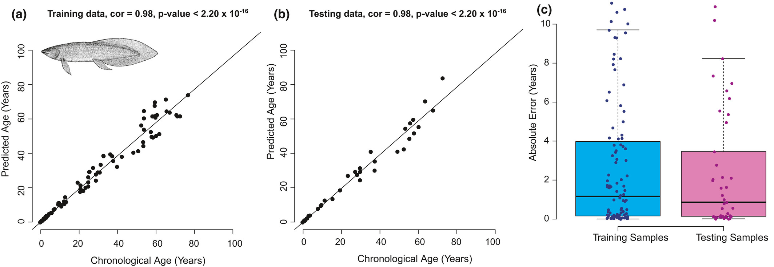
Correlating Methylation Sites with Age
Figure from Mayne et al 2021

Slide 11
What can methylation aging clocks be used for?
Non-lethal samples
Hard to age species
Additional age data for stock assessment models
Cross-validation with other techniques?
Other management applications?

Slide 12
Summary and Take-Home Messages
1. What are epigenetics & methylation?
2. Methylation aging clocks as a non-lethal method
3. Development of aging clocks for fish populations
Broad and powerful mechanisms that provide researchers with an avenue to explore genetic differences
Aging clocks can be calibrated and used for fish/species where structure-based aging is difficult
Small group of methylation sites can be used to estimate age for fish without whole-genome sequencing or otolith extraction

Slide 13
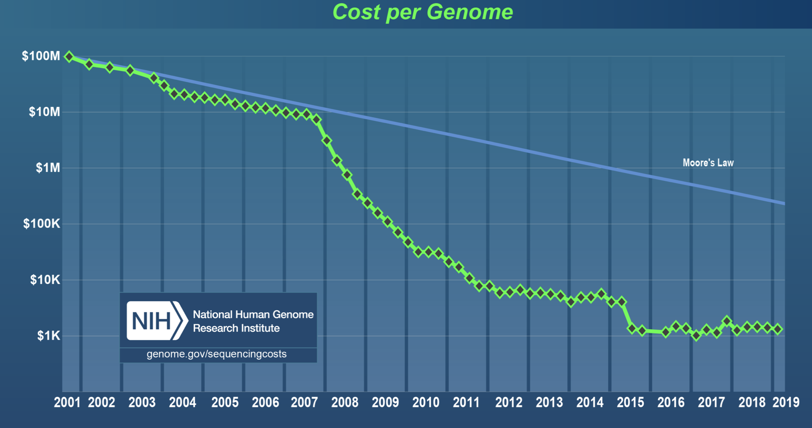
Genomic Sequencing Costs
Cost of sequencing has decreased rapidly in recent years
Largely due to the invention of next generation sequencing
Extraction and library prep is also getting cheaper over time
https://www.genome.gov/sequencingcosts/

Slide 14
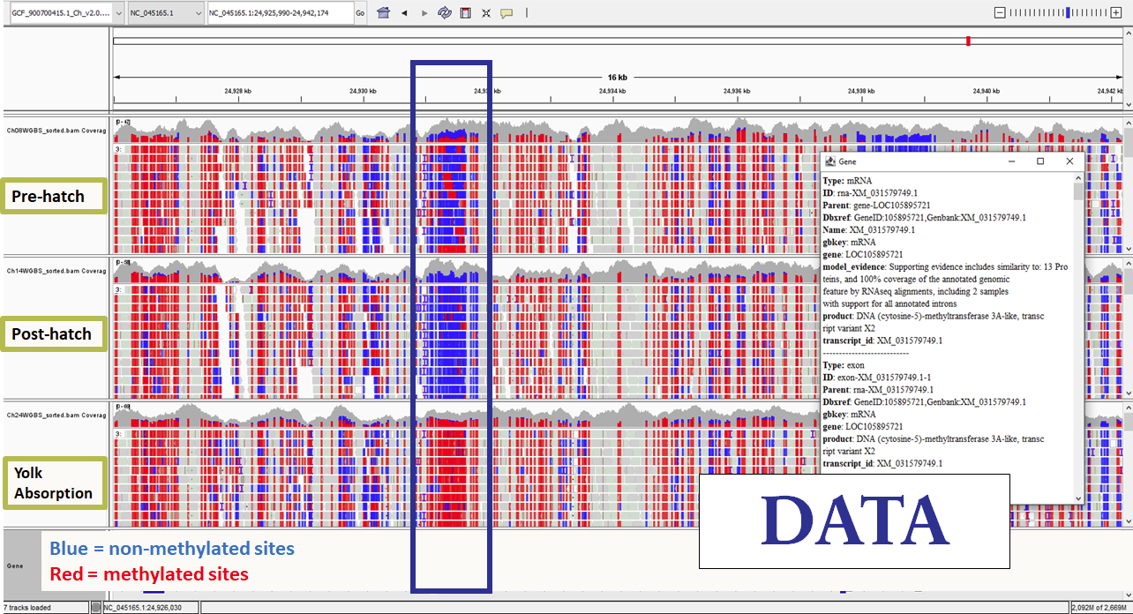

Slide 15
How much does this cost?
Genomics
Otolith aging methods
Tissue processing materials per individual (consumables)
Sequencing
Access to high power computers (HPC clouds)
Storage
Standard operating costs (labour, etc.)
Tissue processing materials per individual (disposables)
Sequencing
Access to high power computers (HPC clouds)
Storage
Standard operating costs (labour, etc.)
+ + + ??? (we are not experts here :P)
...training?

